Slide 1
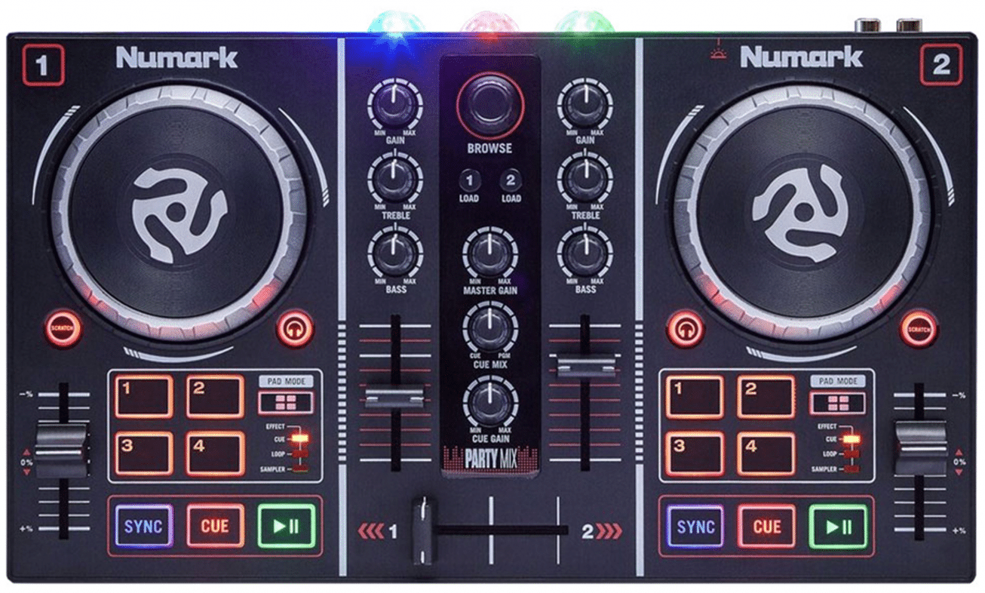
PartyMix: Overview
Gain
Browser /
Cycle LEDs
ColorFX / Treble+Mid/
Load
/ Unload
Bass / FX Depth / FX
Shift #1
PFL
Next Page, goto ColorFX
Temp / Zoom .Range
Shift #2 / Sync / Pad param --
Play Pause / Goto Back
Cue / Pad Param ++

Slide 2
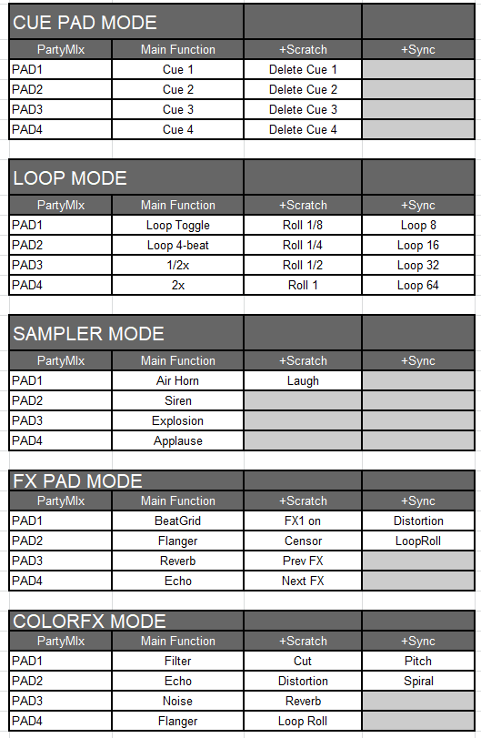
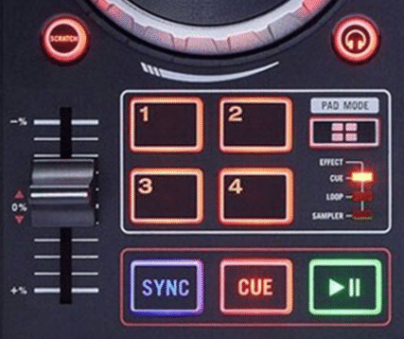
PartyMix: Shifts
PAD MODES:
Shift #1
Shift #2

